Slide 1
AUTOMATION PROJECT
Email Automation

Slide 2


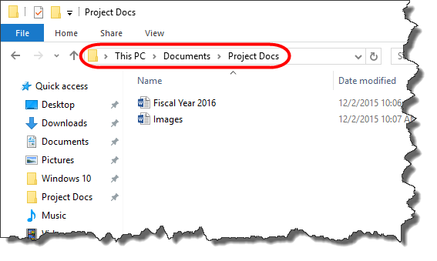


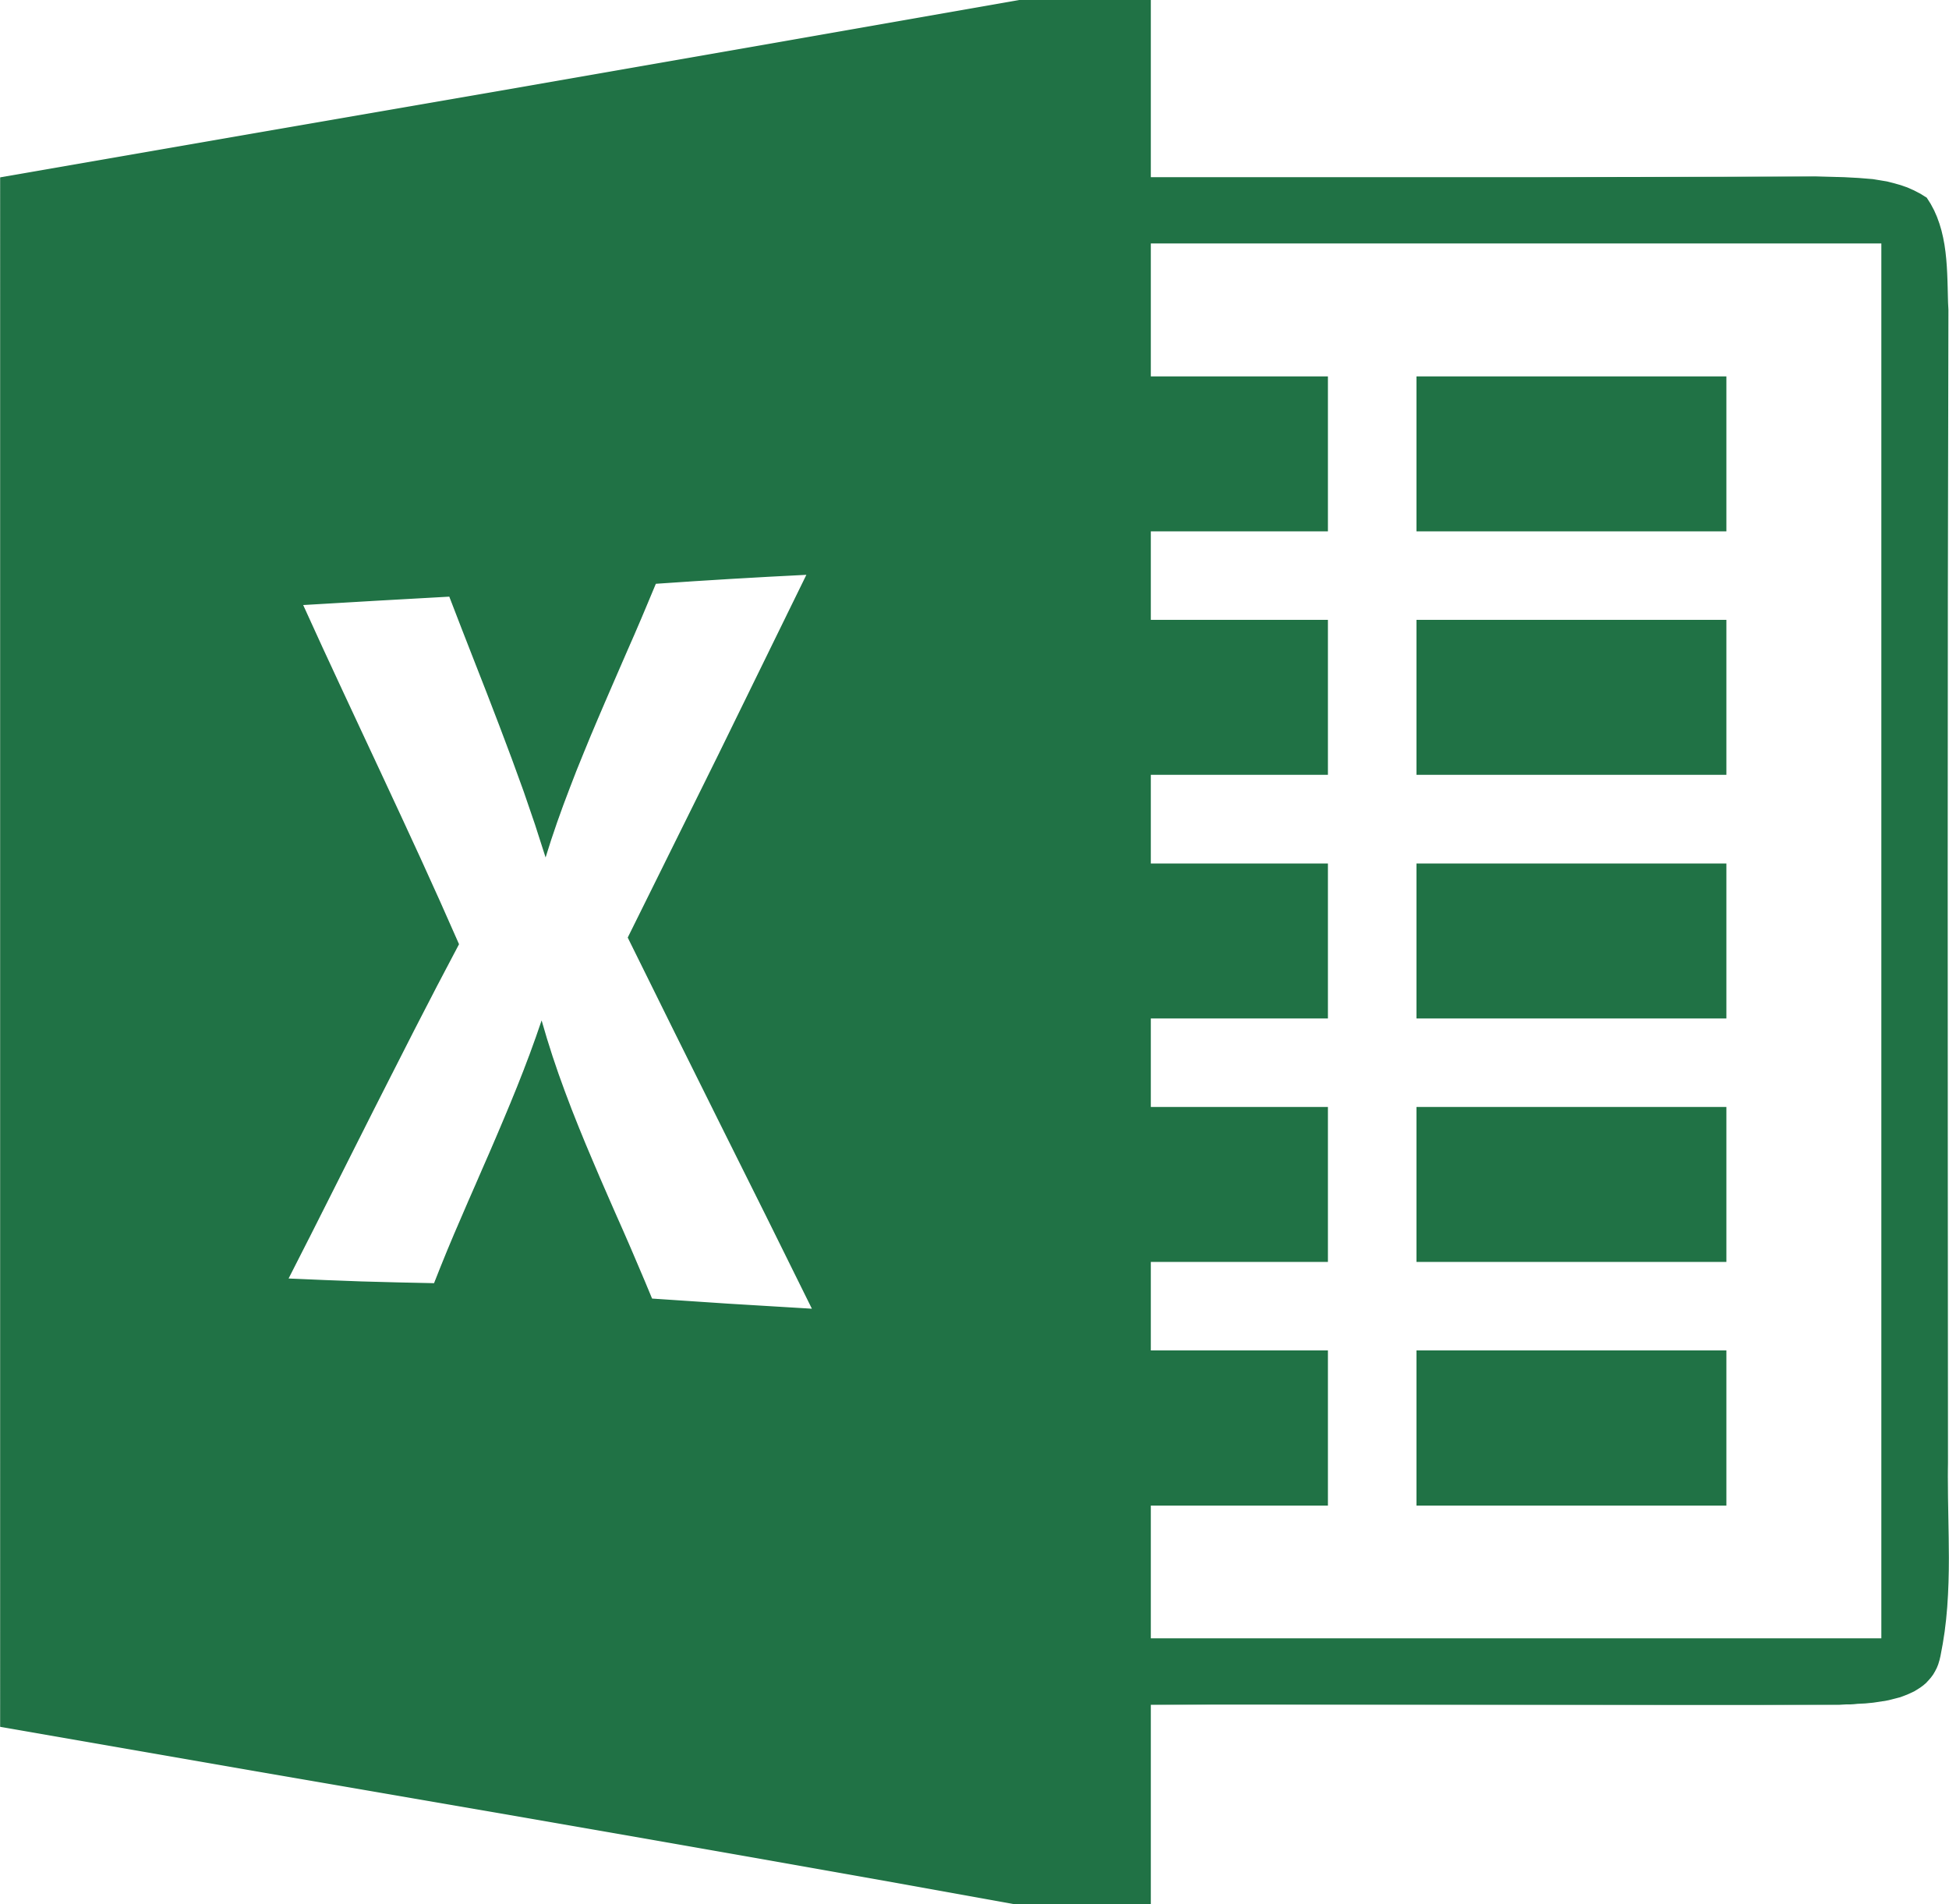

Slide 3

Generating custom letters without Mail merge

Slide 4
#Prompt
Prompt is available in Separate PDF File

Slide 5
Getting Relevant File Path

Slide 6
#Prompt
Now, please provide another Excel VBA code that performs the following:
Allow me to select the folder where all the individual customer PDF files are stored.
The Excel file contains customer names in Column B.
Each PDF file is already named using the customer name (e.g., Ravi_Sharma.pdf).
The VBA code should:
  Search for each customer's PDF in the selected folder based on the name in Column B.
  Add the full file path (including the file name and extension) to Column F in the same row as the customer.
This way, each customer in Column B will have their corresponding PDF file path listed in Column F.

Slide 7

Sending All Emails with Outlook

Slide 8
#Prompt
Now, please provide a VBA code to send emails through Outlook with the following requirements:
The recipient email addresses are listed in Column C.
The file paths for the PDF attachments are listed in Column F.
Each email should include:
  A personalized greeting using the customer name from Column B.
  A relevant subject line.
  A customized email body that includes the customer’s name.
The VBA code should loop through each row, attach the corresponding PDF file from Column F, and send the email to the address in Column C using Outlook.

